Slide 1
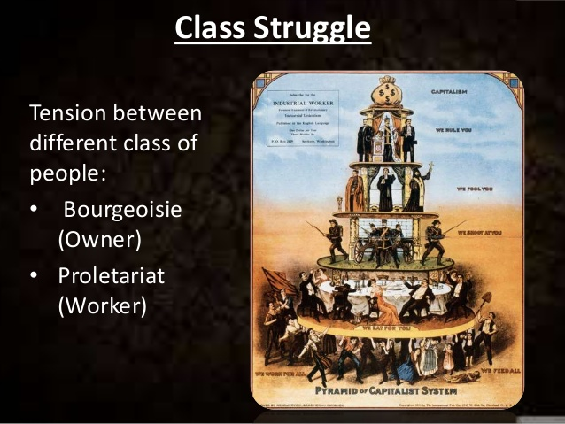
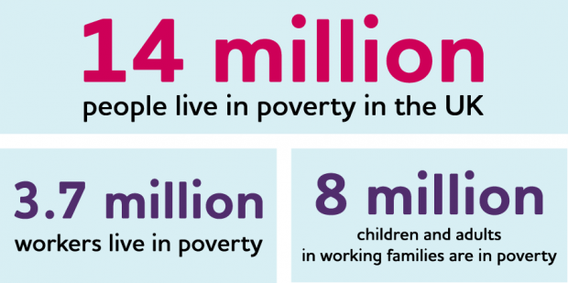
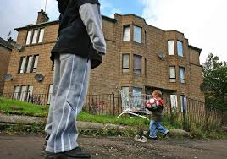
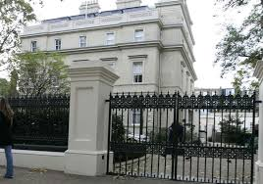
Poverty and Inequality
Week 6 Part 3

Slide 2
Survey evidence from the Royal College of Nursing
66% of White British nurses self-report receiving a sufficient level of eye and face PPE
43% of BAME nurses report receiving sufficient PPE
49% of BAME nurses report having been asked to reuse single use PPE
Vs. 37% of White British nursing staff reporting the same
clear inequalities in perceptions over the provision of PPE training between BAME and White British nurses
BAME healthcare workers may feel less able to speak out against lack of appropriate PPE or exposed working conditions

Slide 3
Recommendations - Immediate actions to prevent increased incidence of disease and further health inequality
Culturally tailored public health messaging
Tailored test, trace and isolate strategy
Priority testing for BAME workers
Mandatory occupational risk assessment for non-NHS staff and NHS staff
Ensuring research quality and equality
Protecting migrants
Closing immediate educational gaps
Strengthening science

Slide 4
Recommendations - Long-term actions to reduce structural inequality:
Reducing health inequality
Addressing occupational inequality
Strengthening social security
Addressing housing inequality
Addressing differential educational achievements
Addressing discrimination in the NHS
Improving health literacy and knowledge relating to lifestyle behaviours

Slide 5
Culturally specific recommendations relate to:
Employers
Places of worship and community centres
Religious festivals
Religious schools
Funerals and burials
Weddings
People providing personal health and hygiene services

Slide 6
Now what does theory say about all of this?

Slide 7
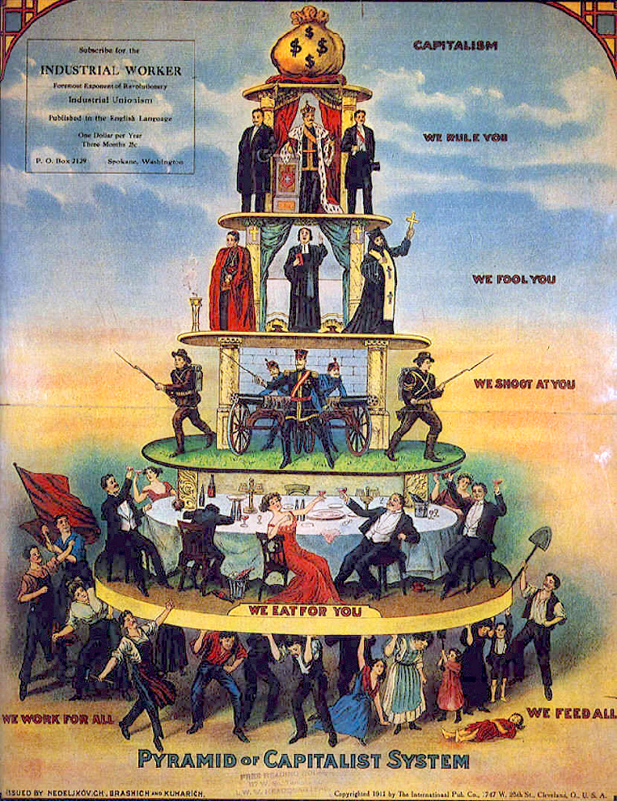
How is society divided?
Social stratification
The division of society into a hierarchy of unequal
groups in society.
Society divided by layers of groups
Where they sit in society depends on which layer they belong to and what advantages/disadvantages they have in comparison to other groups.
One way to look at these different layers is to look at social class.
Marx and Weber = key thinkers

Slide 8
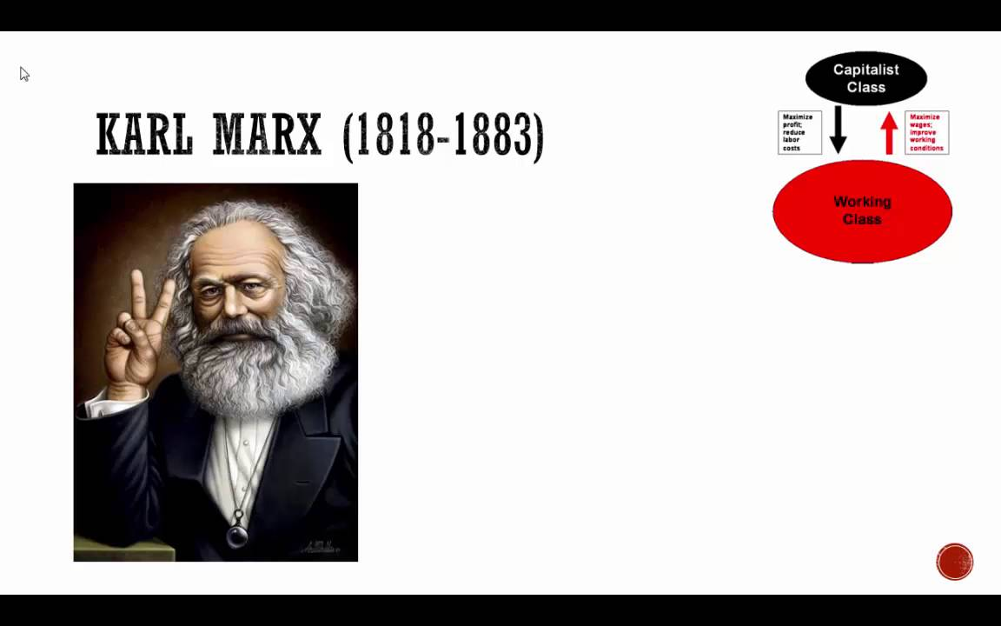
Marx and social class (image source Google.com 2019)
2 classes –
rich (Bourgeoise) ruling class owned property (means of production), factories, industry etc
and the poor working class who worked long hours for small wage
= exploitation of the poor for the benefit of the rich
= conflict between the two groups which would lead to a revolution where poor overthrow the rich and gain equality (Communism).

Slide 9
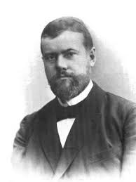
Weber and social class
Source: Google images 2019
Agreed to an extent with Marx
BUT…..
argued that everyone has set skills and abilities which they exchange for income. Labour for a wage depending on what they are good at.
Conflict arises between those who have the same abilities – men and women, old and the young who are competing for the same benefits.
Therefore society is divided by status
Divided by income and wealth from selling skills and abilities.

Slide 10
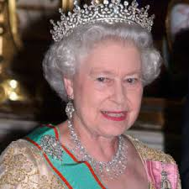
Inequality in income and wealth
What do we mean by wealth?
Ownership of property and goods which can be exchanged for cash
What do we mean by income?
Money received for the exchange of labour, investments, welfare
Difference between earned income and unearned income
Earned income wages
Unearned income – rent on property we own, interest on savings, inheriting money
Distribution of wealth in society is unequal
Rich own the majority of wealth – Queen Elizabeth II in 2010 had assets of £290 million

Slide 11
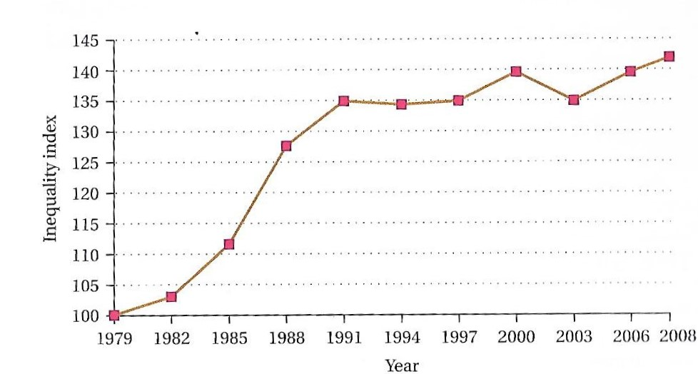
What does this chart tell you?
Fig 1 How Inequality has grown in Britain 1979-2008
(Joyce, 2009 cited in Browne, 2011 p 392)

Slide 12
Inequality in wealth and income
By using this quantitative data we can see that:
In 2008 inequality was higher than in 1979
In 1979 = 100
In 2008 = 142
Quite simply as society has grown so has inequality in income and wealth.

Slide 13
Inequality in wealth
Evident by walking down the street in any city/town
Clear divide between rich and poor
Mansions verses council houses, slum areas,
Rich verses poor, sick, elderly, homeless, unemployed
Poor affected the most as they do not have the same protection from poverty as the rich
Lack investments, money, sick pay and insurance schemes to help at times of difficulty such as unemployment, illness.
Dependent on which social class we belong to.

Slide 14
Not all societies have flushing toilets or any toilet for that matter
No access to fresh water or food
Therefore societies in contemporary world differ
what is seen as essential in one society is not seen as essential in another.
So can we provide a universal definition for relative poverty?
No not really as can not compare like with like.
In 1900s in UK not essential to have a fridge or heating
But in 20th and 21st Centuries it is essential
Therefore definitions, opinions and views also change over time.

Slide 15
How can we explain poverty?
Broadly speaking there are 2 types of explanations
A – the individual – blame the victim approach
B – organisations within society – blame the systems within society/social structure.
Lets compare these

Slide 16
Explaining poverty
A - Individual is to blame
Responsible for own welfare
Throughout history legislation forced poor into circumstances – such as poor laws of 18th century forced poor into work house
20th century penalised poor for dependency on welfare benefits
View that individuals can climb out of poverty (social mobility) if they want to take opportunities to help themselves
If fail to do so then deserve to be poor
B- Society is to blame
Socio economic conditions cause poverty such as the economic boom of 1980s and slump in 2000s.
Changes to education policy and system
Major social divisions within society such as gap between gender, age, class, ethnicity. Disability/ability etc which shape life opportunities
Therefore individuals are not responsible for own poverty

Slide 17
Social inequality is the extremes of wealth and poverty
Should reduce poverty by making society more equal through social and economic policy
Can you think of examples here?
Introduction of the national minimum wage and in work benefits
Attitude of poor = workshy, lazy, underclass reliant on benefit system
Generational unemployment
(See Thatcher, Regan and Murrays views.)

Slide 18
What do you think??
Should we use relative or absolute poverty to define poverty in the UK?
Should we use relative or absolute poverty to define poverty in other countries such as Africa, Bangladesh, Mozambique where 1/3 of population is in poverty,
or Rowanda 2/3 population are in poverty?

Slide 19
Critique
Difficult as no clear definition or universal definition
Depends on the society and level of affluence and social development
What is a basic or essential item?
Who selects what these are?
What is the difference between need and want? For example, do we need a fridge to survive? Or do we want a fridge?

Slide 20
Let us look at a current example
https://www.bbc.co.uk/news/uk-53039816
Coronavirus: 'Scandal' BAME review recommendations 'buried'
The review, the second by PHE on the subject, pointed to discrimination as a root cause affecting health and the risk of both exposure to the virus and becoming seriously ill as a result of it.
It found that historic racism may mean people were less likely to seek care or demand better personal protective equipment, while other potential factors included risks linked to occupation and inequalities in conditions such as diabetes.

Slide 21
Conclusion
Defined social inequality, poverty and class?
Discussed why social inequality and poverty is an issue?
We have looked at:
Social stratification and class
Income and wealth – inequality
Poverty and inequality

Slide 22
References
Bellamy, R. (2008) Citizenship: A very short introduction, Oxford, Oxford University Press.
Browne, K. (2011) An Introduction to sociology, (4th edn) Cambridge, Polity Press.
Giddens, A & Sutton, P.W. (2017) Essential concepts in sociology, (2nd edn), Cambridge, Polity Press.
Google Images (2019)Karl Marx available at: https://www.google.com/search?q=social+stratification&tbm=isch&tbs=rimg:CQEgz7M-VK8HIji8WcH2RvYFC9Ss1FlFVlt5irWl2-3I_1EZNbD5_1UCPlYj_1BDA97dCsx6sHsDt7tJmIcPU4FwQa_1FioSCbxZwfZG9gULEZYHjEScsC_1UKhIJ1KzUWUVWW3kR-ZnU2gV-CGMqEgmKtaXb7cj8RhHdFcPC9sHldyoSCU1sPn9QI-ViEVyp5lR2YsjXKhIJP8EMD3t0KzERRzk9yY0XLVMqEgnqwewO3u0mYhEwoFM8d_1CtdSoSCRw9TgXBBr8WEc_1y2UxyL5Zv&tbo=u&sa=X&ved=2ahUKEwj-0MqbpbbhAhVnyoUKHWwoApkQ9C96BAgBEBs&biw=1536&bih=706&dpr=1.25#imgrc=6sHsDt7tJmL_QM:

Slide 23
Google Images (2019) Max Weber available at: https://www.google.com/search?biw=1536&bih=706&tbm=isch&sa=1&ei=n-SlXKiiAY2H1fAP0oid6A4&q=max+weber+social+stratification&oq=weber+social+stratification&gs_l=img.1.0.0i5i30.214081.215565..217962...0.0..0.66.337.6....1..1....1..gws-wiz-img.......0i7i30j0i7i5i30.CVWiupvUUK8#imgrc=R3GX7eHACp06wM:
GOV.UK (2020) https://www.gov.uk/government/publications/the-national-minimum-wage-in-2020

